Slide 1

Enhancing Policy Response and Socio-Economic Welfare Through Data Insights
BUAD 5272: DATABASE MANAGEMENT
Presented By Sam Pritchard, Cathy Fan and Lydia Adzobu

Slide 2

Agenda
01
Project Proposal
02
Dimensional Modelling
03
ETL Processes & Output
04
Analytics & Insights
05
Concluding Remarks

Slide 3
Business Proposal
The purpose of this project is to design and implement a data warehouse that consolidates Health and economic datasets will support data-driven decision making in socio-economic welfare and food security.
INFORMATION NEEDS & SOURCES
ELEMENTS OF THE DIMENSIONAL MODEL
FACT TABLES: ECONOMIC, FOOD AND COVID FACT TABLES. DIMENSIONS: DEMOGRAPHICS, LOCALITY, CALENDAR
DATA AND INSIGHTS: EMPLOYMENT TRENDS, COVID HEALTH DATA, FOOD BANK GROUP ACTIVITIES.
SOURCES:
VIRGINIA OPEN DATA PORTAL
US DEPARTMENT OF AGRICULTURE
Results
KEY ANALYTICS AND MEASURES
TARGET ORGANIZATIONS
UNEMPLOYMENT RATES BY YEAR AND COUNTY, FOOD DISTRIBUTION BY COUNTY, COVID CASES PER COUNTY, EMPLOYMENT RATES
VIRGINIA GOVERNMENT, CHAMBER RVA, CHARITABLE ORGANIZATIONS AND BUSINESES, SENTARA HEALTH

Slide 4

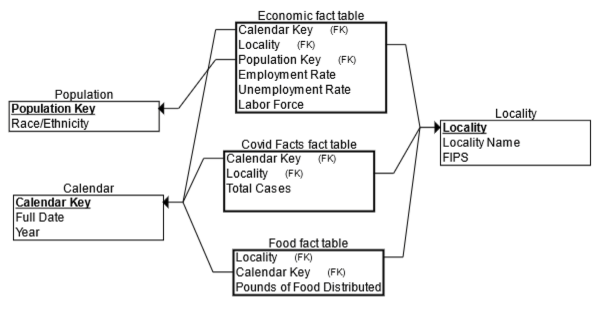
Dimensional Model(Ante) – Star Shema

Slide 5
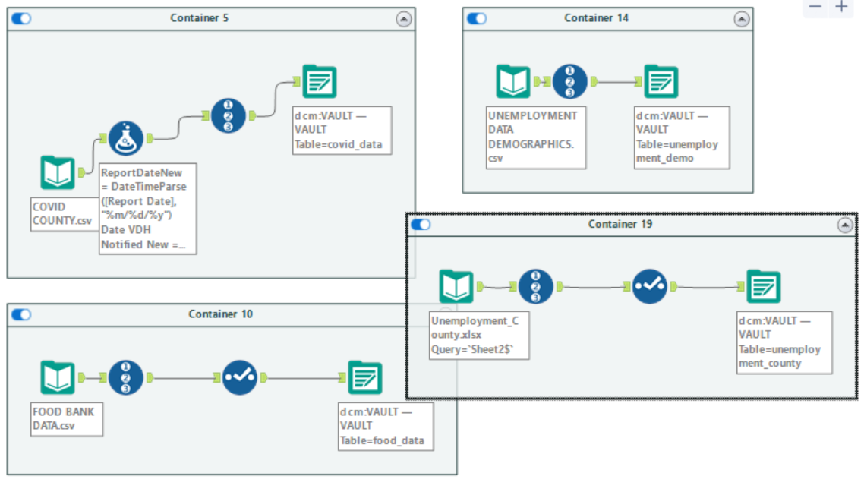

ETL Process: Cleaning Raw Data
Covid Data
Unemployment data 1
Unemployment data 2
Food data
Overview:
Changing Date Formats
Adding RecordIDs
Selecting Records relevant to our Datawarehouse

Slide 6
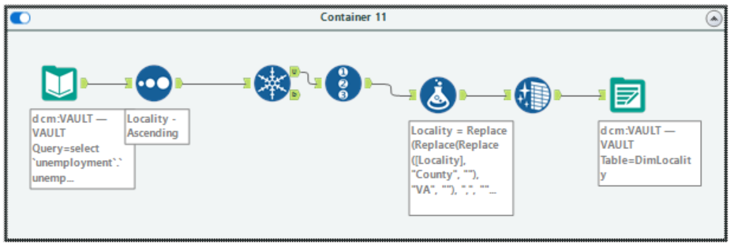
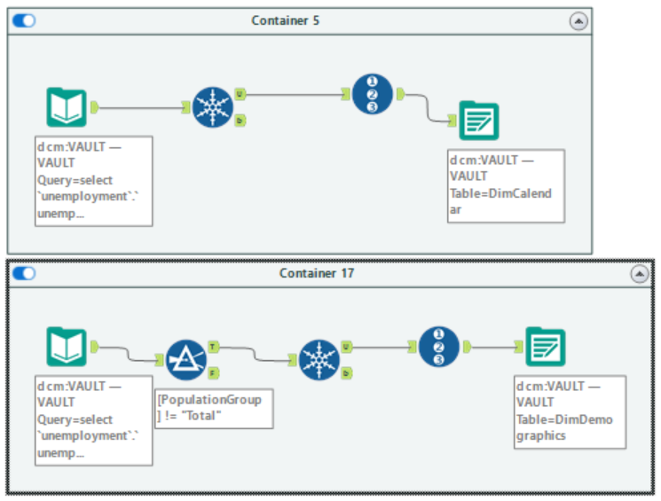
ETL Process: Dimension Tables
Locality Dimension
Calendar Dimension
Overview:
Filtering for Unique Records
Formatting Variables to Prepare Dimensions for Joins
Adding Surrogate “_____Key”
Demographics Dimension

Slide 7
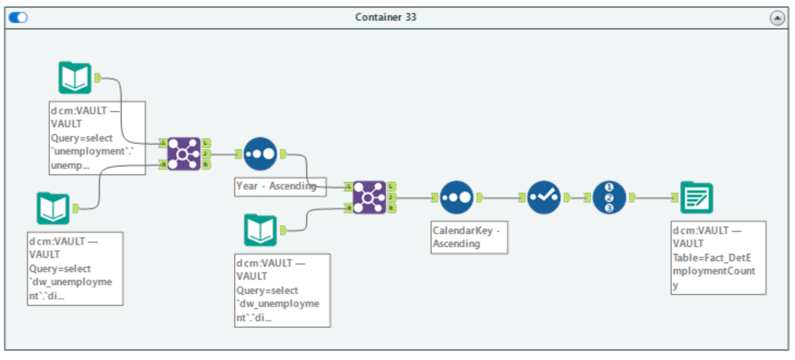
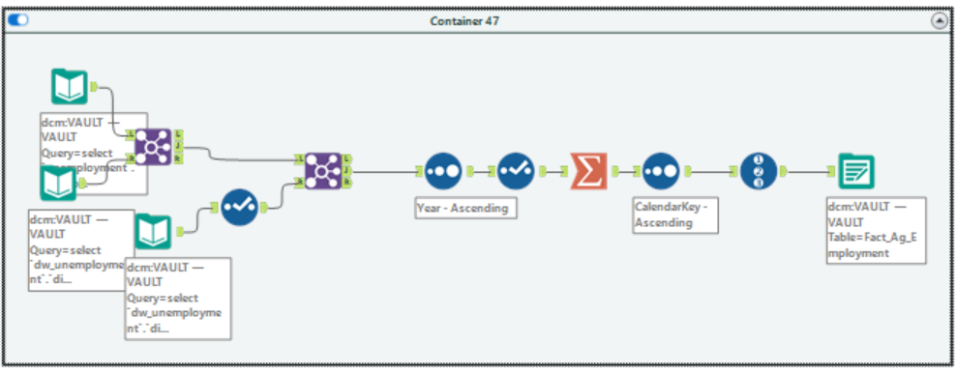
ETL Process: Fact Tables
Overview:
Joining Multiple Tables
Sorting to make the Data clear
Summation Tool to perform “Group By” and “Sum” operations
Creating Surrogate Keys
Detailed Employment by County Fact Table
Aggregated Employment Fact Table

Slide 8
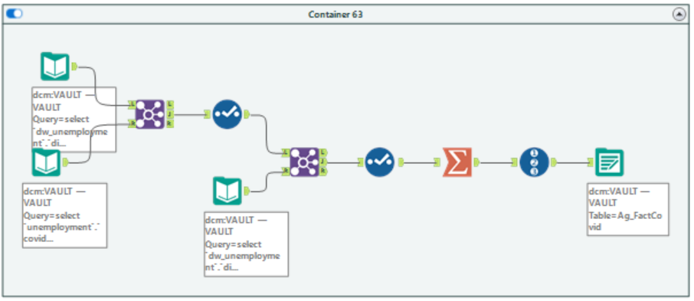
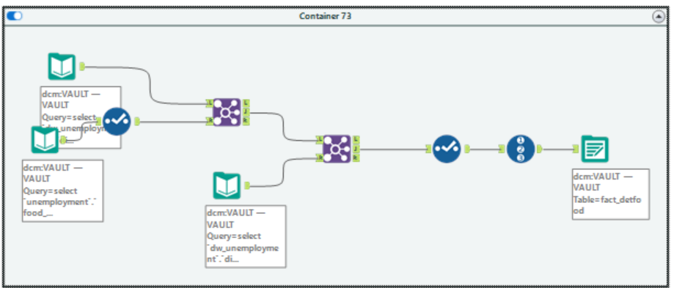
ETL Process: Fact Tables
Aggregated COVID Fact Table
Final Product:
Three Cleaned Datasets
Three Dimensions
Two Detailed Fact Tables
Two Aggregated Fact Tables
Detailed Food Fact Table

Slide 9
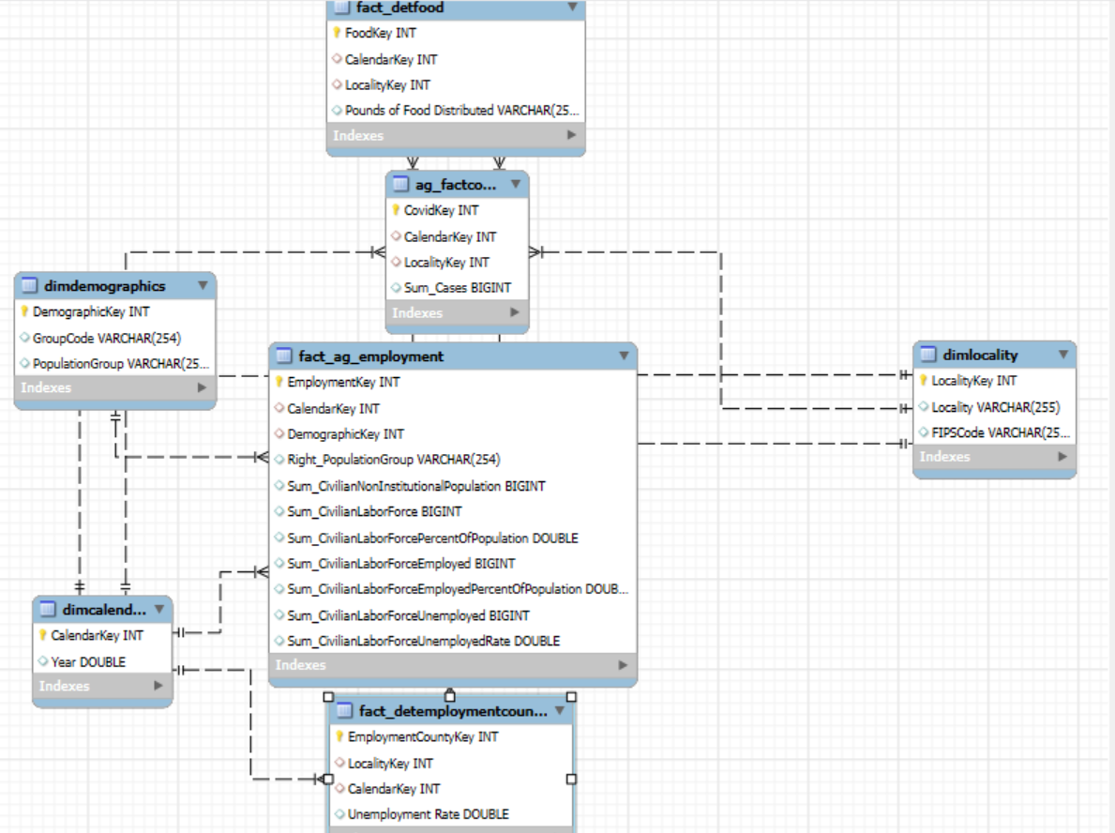
Dimensional Model(Ex-Post)

Slide 10
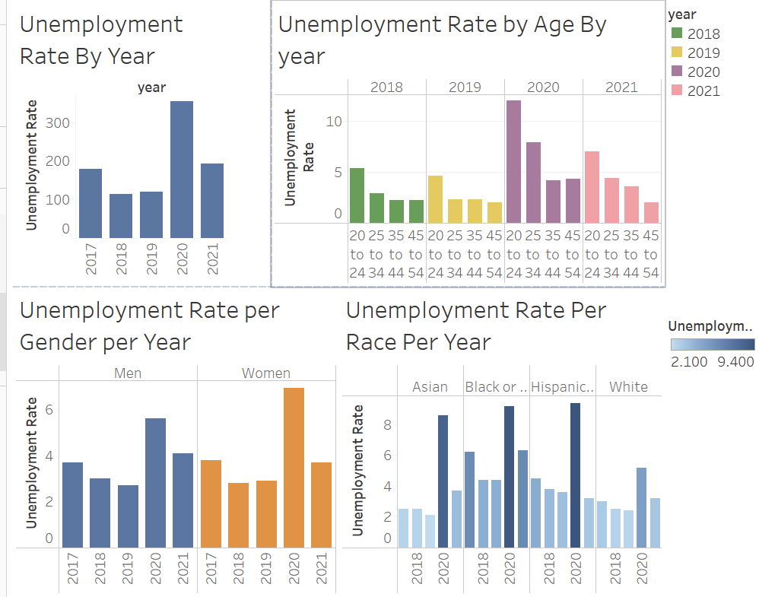
Analytics: Economic Metrics & Insights

Slide 11
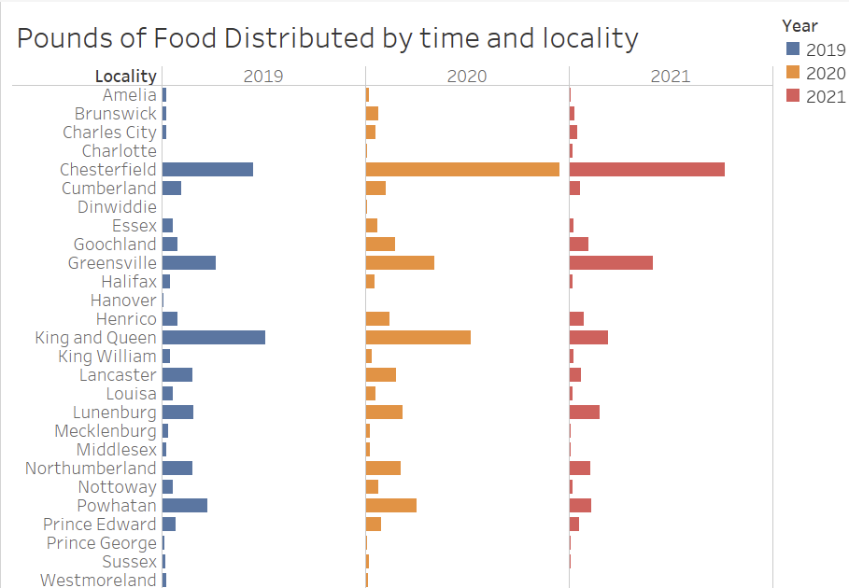
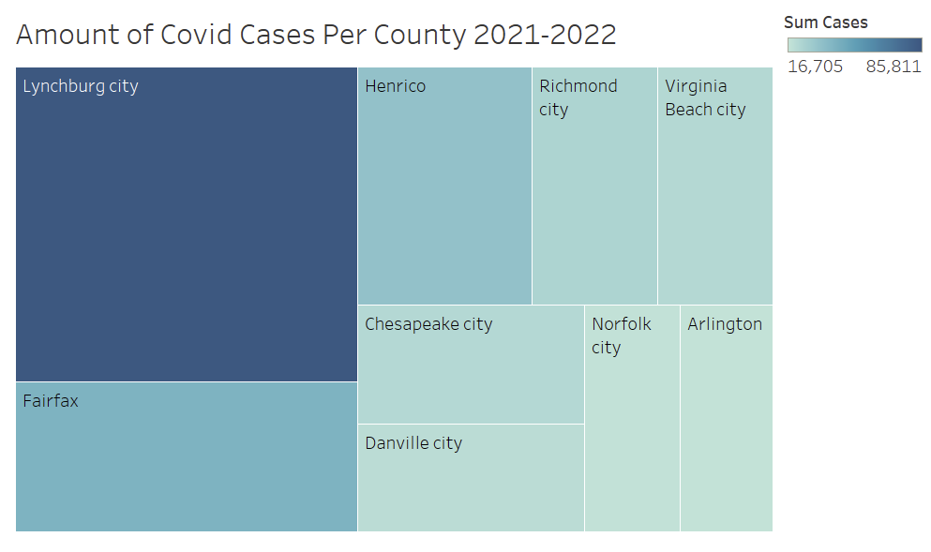
Analytics: Economic Metrics & Insights

Slide 12
Data Warehouse Development: Key Challenges and Lessons
DATA AVAILABILITY
1
Finding the right data sets that complemented each other and met the project objectives was challenging
CLEANING AND DATA STRUCTURING
We experienced challenges structuring the data to comply with the logical model(star schema) in Alteryx, especially when it came to creating the second and third fact tables as we encountered challenges with SQL
2
VISUALIZATION WITH TABLEAU
3
We found it easy to use SQL queries to extract data from our newly developed warehouse into CSV files which we imported into TABLEAU visualize. We realize we could have just used the connection we had set up between TABLEAU AND SQL.
4
CONCLUSION
We believe that our data warehouse can serve the purpose it was created for adequately and can be augmented with more economic and health related metrics for decision making.

Slide 13
References
Virginia Open Data Portal. (2024). COVID-19 Cases and Vaccination Data in Virginia. Virginia Open Data Portal. https://data.virginia.gov
Virginia Open Data Portal. (2024). Virginia Employment Status of the Population by Sex by Race and by Age by Year .Virginia Open Data Portal. https://data.virginia.gov
Virginia Open Data Portal. (2024). Virginia Employment Status of the Population by Sex by Race and by Age by Year . Virginia Open Data Portal. https://data.virginia.gov
US Department of Agriculture(2014-2022). Unemployment Rate by County. https://data.ers.usda.gov/reports.aspx?ID=17828

